Slide 2

Image to Cartoon using GAN
Lê Hoàng Anh– 20224297
Vũ Minh Hiển - 20224311

Slide 3
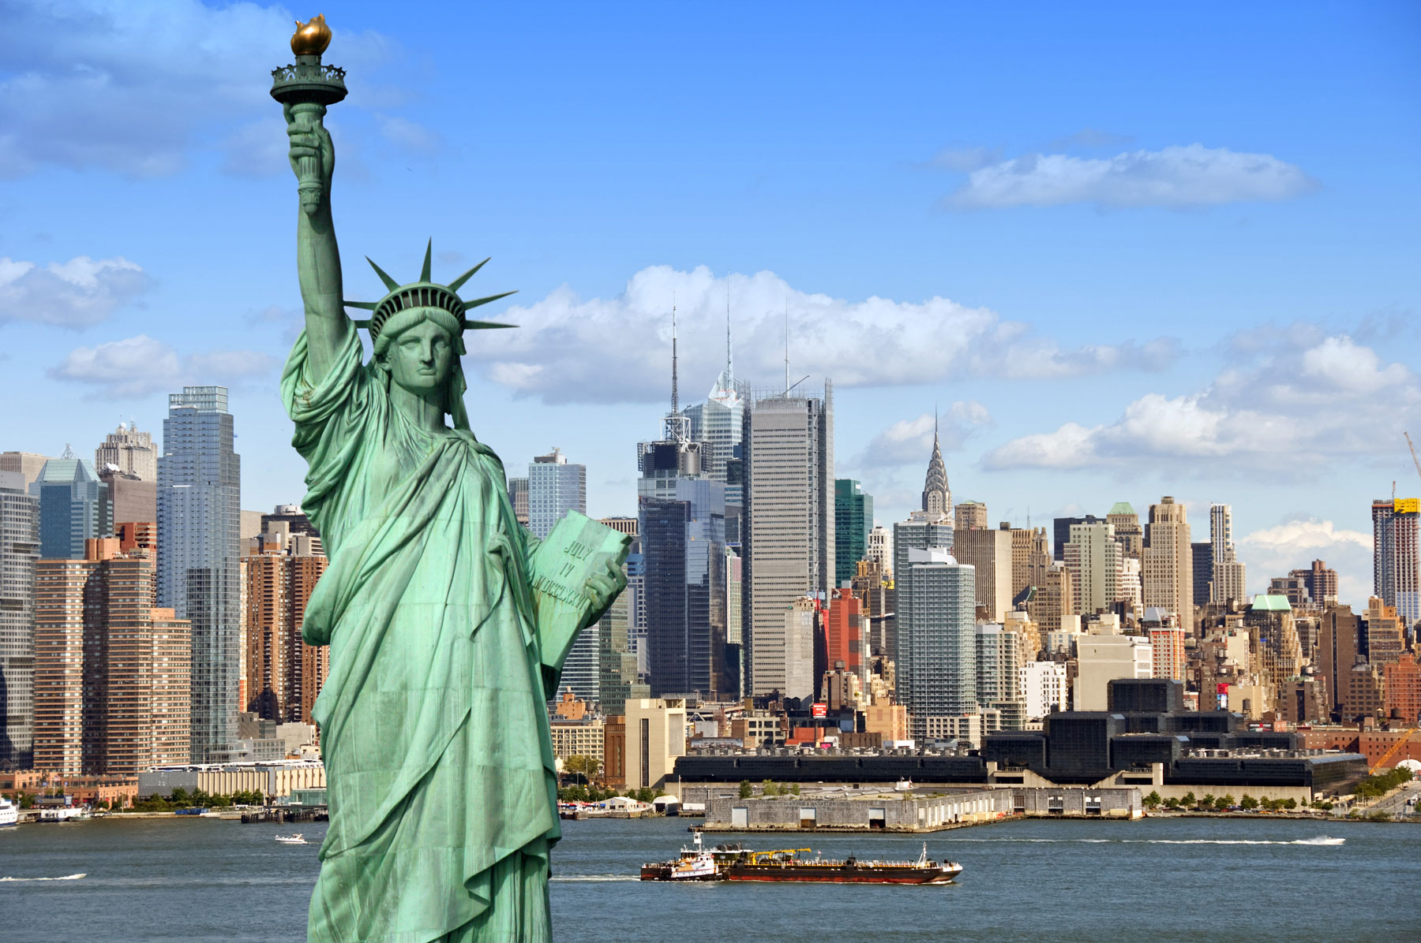
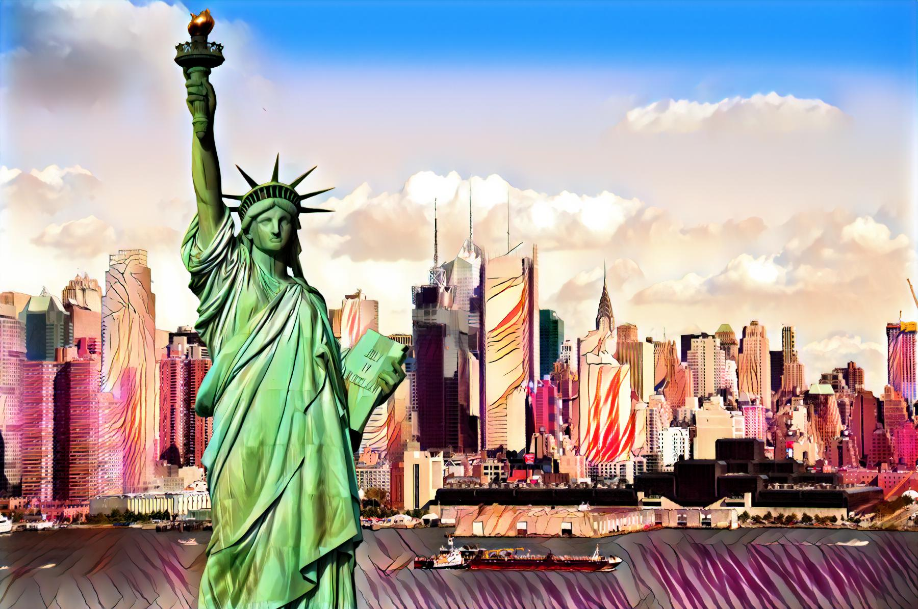
INTRODUCTION
Figure1: Input and Output
Notes:
First I get 40 images which collected at VNUF on August 24th, 2024 for my 3D reprenstation

Slide 4
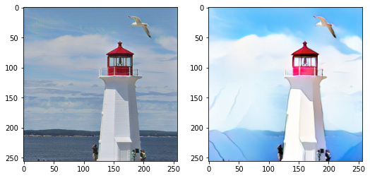
INTRODUCE
1. Statement: Transform real-world photos into high-quality cartoon-style images with the following characteristics:
High-level abstraction.
Clear edges.
Smooth color shading and simple textures.
2. Challenges:
Significant differences between real photos and cartoon styles.
Existing methods fail to capture the unique features of cartoonization.
Notes:
Here is a briefly description about Dataset

Slide 5
INTRODUCE
3. Proposed Solution:
CartoonGAN: A GAN-based framework specifically designed for cartoon stylization.
Training Data: Utilizes unpaired real photos and cartoon images for training.
4. Key Contributions:
Semantic Content Loss: Implements sparse regularization on high-level feature maps of the VGG network to preserve content despite substantial style differences.
Edge-Promoting Adversarial Loss: Enhances the reproduction of clear edges, a key characteristic of cartoon images.
Initialization Phase: Improves network convergence and training efficiency.
Notes:
Here is a briefly description about Dataset

Slide 6
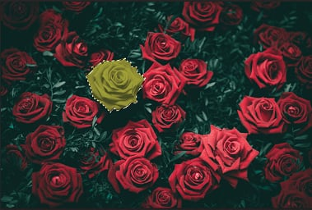
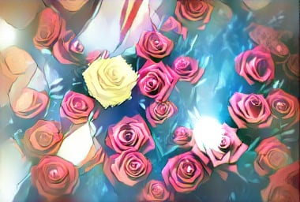
INTRODUCE
5. Results:
Generates high-quality cartoon images with clear edges and smooth shading, aligning with specific artists' styles.
Outperforms state-of-the-art methods in cartoon stylization.
Notes:
Here is a briefly description about Dataset

Slide 7
RELATED WORK
2.1 Stylization with Neural Networks
Neural Style Transfer (NST):
- Gatys et al. pioneered using CNNs to transfer styles from one image to another, leveraging VGG feature maps.
- Limitations include dependency on content-style similarity and difficulties with cartoon styles, such as reproducing clear edges and smooth shading.
Alternative Approaches:
- CNNMRF (Li & Wand): Local matching in CNN features but prone to semantic mismatches.
- Deep Analogy (Liao et al.): Maintains semantic correspondences during style transfer but relies heavily on chosen patches.
Our Approach: (CartoonGAN)
- Learns cartoon styles using two separate datasets (real photos and cartoon images), avoiding dependency on individual style images.

Slide 8
RELATED WORK
2.2 Generator Network (G):
Purpose: Maps real-world photos to the cartoon manifold to produce stylized images
Architecture:
Flat Convolution Stage: Extracts local signals.
Down-Convolution Blocks: Compress and encode spatial features.
Residual Blocks: 8 identical blocks used to construct content and manifold features.
Up-Convolution Blocks: Reconstruct cartoon-style images with:
- Fractionally strided convolutional layers (stride = 1/2).
- A final 7×7 convolutional layer.

Slide 9
RELATED WORK
2.2 Discriminator Network (D):
Purpose: Judges whether an input image is a real cartoon image.
Architecture:
Patch-level Discriminator:
Focuses on local features rather than the entire image.
Uses fewer parameters since cartoon style discrimination relies on local cues.
Network Structure:
Flat Layers Stage: Initial processing of the input image.
Strided Convolution Blocks: Reduces resolution and encodes local features.
Feature Construction Block 3x3 Convolutional Layer: Generates the classification response.

Slide 10
RELATED WORK
2.2 Generator Network (G):
Purpose: Maps real-world photos to the cartoon manifold to produce stylized images
Architecture:
Flat Convolution Stage: Extracts local signals.
Down-Convolution Blocks: Compress and encode spatial features.
Residual Blocks: 8 identical blocks used to construct content and manifold features.
Up-Convolution Blocks: Reconstruct cartoon-style images with:
- Fractionally strided convolutional layers (stride = 1/2).
- A final 7×7 convolutional layer.

Slide 11
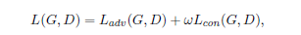
LOSS FUNCTIONS
The loss function 𝐿(𝐺,𝐷) in CartoonGAN combines two components:
Adversarial Loss 𝐿adv(𝐺,𝐷): Guides the generator 𝐺G to transform input images into the cartoon manifold.
Content Loss 𝐿con(𝐺,𝐷):Ensures the semantic content from the input photo is preserved in the generated cartoon image.
Defined as:
Where ω controls the balance between content preservation and stylization
(set to 𝜔=10 in experiments).

Slide 12

LOSS FUNCTIONS
Adversarial Loss 𝐿adv(𝐺,𝐷):
Encourages the generator G to produce outputs that resemble real cartoon images.
To address the challenge of clear edge reproduction (critical for cartoon images), a set of cartoon-like images without clear edges 𝑆data(𝑒) is created by:
Detecting edges using the Canny edge detector.
Dilating the edge regions.
Applying Gaussian smoothing on these regions.
The discriminator D learns to:
Recognize real cartoon images 𝑆data(𝑐).
Differentiate between cartoon-like images without edges 𝑆data(𝑒)S data​ (e) and generated images 𝐺(𝑝𝑘)).

Slide 13
LOSS FUNCTIONS
Figure 2: By removing clear edges in a cartoon image ci ∈ Sdata(c), we generate a corresponding image ei ∈ Sdata(e).

Slide 14

LOSS FUNCTIONS
Content Loss 𝐿con(𝐺,𝐷):
Ensures the preservation of semantic content between the input photo and the generated cartoon image.
Uses high-level feature maps from a pre-trained VGG network (layer ‘conv4_4’) to measure content similarity.
Employs ℓ 1​ -norm regularization instead of ℓ2​ -norm to handle the distinct characteristics of cartoon images (clear edges and smooth shading).
Defined as:

Slide 15
INITIALIZATION PHASE
Challenge:
Due to the nonlinear nature of GAN models, random initialization often leads to suboptimal local minima during optimization.
Solution: Introduce a new initialization phase to improve convergence.
Goal of Generator Network (G): Transform input photos into cartoon style while preserving semantic content.

Slide 16
INITIALIZATION PHASE
4. Initialization Phase:
- Begin adversarial learning with a generator that only reconstructs the content of the input image. - Pre-train the generator network G using only the semantic content loss 𝐿con(𝐺,𝐷).
- Example: After 10 epochs, the reconstructed image already produces reasonable results.
Figure 4. For an original photo (a), the image (b) is the result after the initialization phase. See the main text for details.

Slide 17
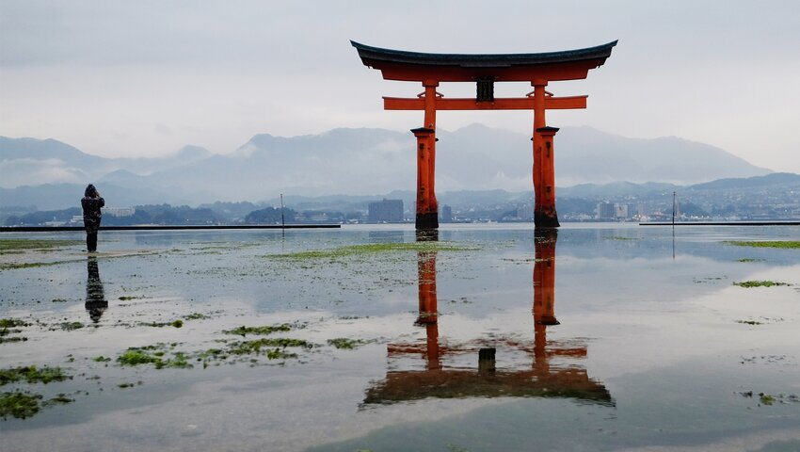
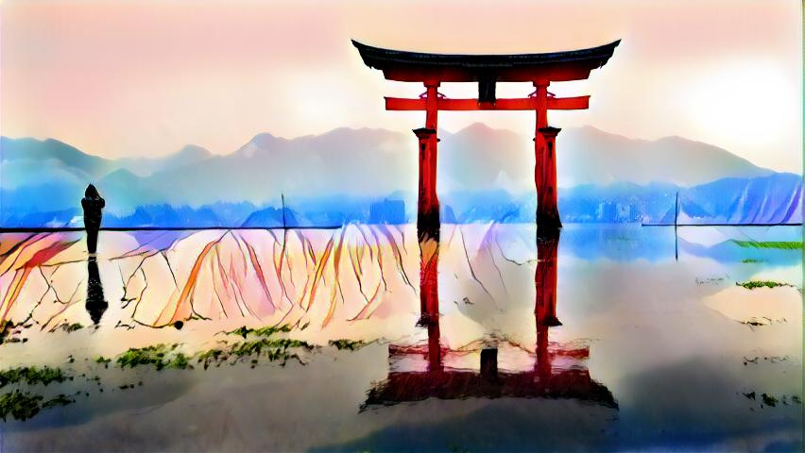
RESULT
In this paper we proposed CartoonGAN, a Generative Adversarial Network to transform real-world photos to high-quality cartoon style images.
Figure 5. Result

Slide 18
FUTURE WORK
In future work, due to the importance of portrait images, we aim to explore how to leverage local facial features to improve cartoon stylization for human faces. While our loss functions are tailored to address the specific challenges of cartoon stylization, the underlying concepts can also be applied to other image synthesis tasks, which we plan to investigate further. Furthermore, we intend to introduce sequential constraints into the training process to extend our method to video handling

Slide 19
THANK YOU !

